Slide 1

Crop Census
A machine-learning decision-support system for crop, fertilizer, yield and rainfall guidance
Suman P · USN P03BX24S126046
MCA IV Semester, Bangalore University · 2024–26
Guide: Mr. Darshan N, Assistant Professor, Dept. of Computer Applications
City College, Jayanagar, Bengaluru
Notes:
Introduce yourself and the project: Crop Census, a web-based ML decision-support tool for farmers.

Slide 2
Abstract
The challenge
Farmers often choose crops, fertilizer and plan around rainfall using experience alone, which can miss changing soil and weather conditions.
The solution
Crop Census is a machine-learning web app that turns agricultural datasets into simple, actionable recommendations and estimates.
The stack
Python (scikit-learn, pandas, NumPy) backend; HTML, CSS, Bootstrap 4 and JavaScript frontend.
5
agricultural tools in one web application
Datasets used
Crop · Soil · Weather · Yield
Notes:
Summarise in 30 seconds: problem, ML-based solution, technology, and the five tools.

Slide 3
Introduction
Agriculture underpins food security and the economy.
Decisions on crops, fertilizer, rainfall and yield still lean on intuition and local knowledge.
Crop Census applies predictive analytics so farmers can decide with data, improve productivity and reduce risk.
Objectives
1
Predict crops for a state, district and season
2
Recommend a crop from soil and climate values
3
Suggest fertilizer for soil type and crop
4
Estimate rainfall from historical data
5
Estimate crop production for planning
Notes:
Explain why data-driven agriculture matters, then walk through the five objectives.

Slide 4




Problem statement
Soil nutrients
Weather
Location and season
Cultivated area
Crop choice, fertilizer, yield and rainfall planning depend on all of these factors at once. Farmers struggle to weigh them together or find the data in one place, so decisions rest on limited information.
Crop Census gives data-based results as decision support, not a replacement for expert advice.
Notes:
Four inputs drive every decision; the gap is bringing them together in one tool.

Slide 5
Literature review
Task | Technique | Inputs
Crop recommendation | Random Forest classifier (10 trees) | N, P, K, temperature, humidity, pH, rainfall
Fertilizer recommendation | Decision Tree classifier | Nutrients, climate, moisture, soil type, crop
Crop prediction | Gini-based Decision Tree | State, district, season
Production estimate | Random Forest regressor (100 trees) | State, district, season, crop, area
Rainfall estimate | Historical monthly average | Region, month
Crop recommendation and fertilizer advice are classification problems; production is regression. Rainfall is a historical average, not a forecast.
Notes:
Each tool maps to a standard ML technique from agricultural decision-support literature. Mention that results depend on data quality and coverage.

Slide 6




Proposed system
Crop recommendation
Fertilizer recommendation
Crop prediction
Production estimate
Rainfall estimate
Best crop from soil and climate
Fertilizer for soil and crop
Crops by state, district, season
Output from area and crop
Monthly average by region
Today
Experience and scattered sources; no single integrated tool.
Advantages
One place, structured inputs, location and season awareness, user accounts.
Notes:
Five tools in one web app. Contrast with the current approach of relying on experience and separate sources.

Slide 7
Methodology
1
2
3
4
5
Collect data
Prepare
Train models
Integrate
Test
›
›
›
›
Crop, soil, weather and production CSV datasets
Split features and labels; encode categories; 80/20 train-test split
Random Forests, Decision Tree and a saved Gini tree
Web forms pass inputs to Python scripts
Unit, integration, system, validation and acceptance
At run time, the crop, fertilizer and production models are trained when their script is called; the crop-prediction tree is loaded from a saved file.
Notes:
Five-stage process from data to testing. Note the testing plan is manual; results should be recorded after execution.

Slide 8


Software and hardware requirements
Hardware
Software
64-bit dual-core processor or better
4 GB RAM or more
About 2 GB free storage
User device: any with a modern browser
Internet or local network access
Windows or Linux
Apache or compatible web server
MySQL server with PDO driver enabled
Python with pandas, NumPy, scikit-learn
Modern browser with JavaScript
Notes:
Modest requirements: a standard web-server setup with Python libraries and MySQL.

Slide 9
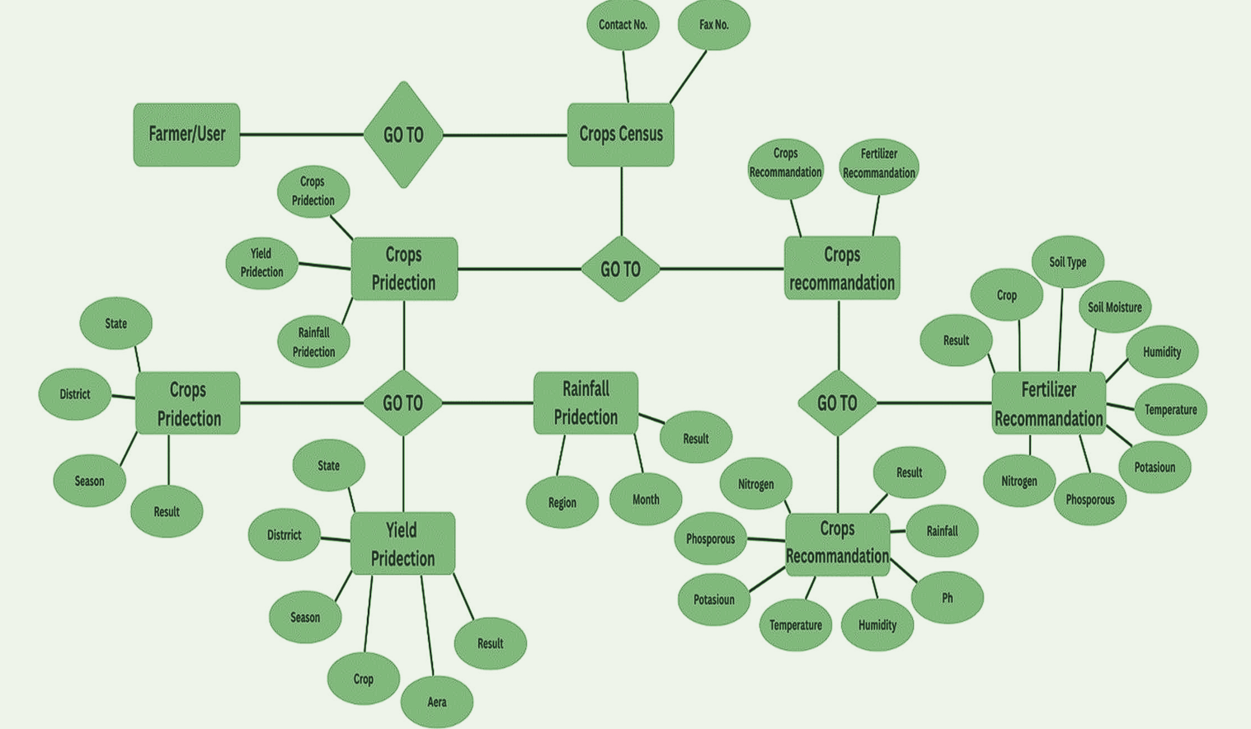
ER diagram
Notes:
ER diagram: the Farmer/User goes to Crops Census, which links the prediction and recommendation modules, each with its input attributes and a result.

Slide 10
Data flow diagram: Level 0
Login data
MySQL user database
HTTP request
Crop Census System
Inputs
Farmer / Visitor
Web Browser
Request
Results
Page or result
Local datasets and saved model
Data or model output
Notes:
Context diagram: the farmer interacts through a browser; the system reads user accounts from MySQL and datasets/models from local files.

Slide 11
Data flow diagram: Level 1
1 Account management
MySQL users table
2 Crop recommendation
Crop recommendation CSV
Farmer / Visitor
Web pages and forms
3 Fertilizer recommendation
Fertilizer CSV
4 Crop pattern prediction
Saved crop decision tree
5 Yield prediction
Crop production CSV
6 Rainfall estimate
Historical rainfall CSV
Notes:
Six processes: accounts plus the five tools. Each reads from its own dataset or model; only accounts use MySQL.

Slide 12


Conclusion
One platform
Crop and fertilizer recommendations, crop patterns, production estimates and rainfall averages in one web app.
Built on
Web interface, MySQL user accounts, Python models and local agricultural datasets.
Supports planning, and does not replace local agricultural expertise.
Used wisely
Outputs are estimates from the datasets; rainfall is a historical average, not a forecast.
Notes:
Wrap up: integrated tools, honest limits, decision support.

Slide 13

Future scope
Better models
Fresh data
Live weather
Evaluate with test data and metrics; compare algorithms.
Track sources and dates; refresh datasets regularly.
Add a trusted service for current conditions and forecasts.
Wider coverage
Stronger validation
Smarter chat assistant
More regions, crops and seasons, supported consistently.
Check value ranges and units; show clear errors.
Multilingual support and review of answers before submitting.
Also: automated tests, monitoring and secure configuration for responsible deployment.
Notes:
Priorities: model evaluation and data freshness first, then live weather and wider coverage.

Slide 14
Thank you
Questions and discussion
Suman P · Guide: Mr. Darshan N · City College, Bengaluru

